Slide 1
Spatial AI and Its Applications
Air Quality Prediction and Machines Reading Maps
Yao-Yi Chiang
Associate Professor, Computer Science & Engineering Department
University of Minnesota, Twin Cities
yaoyi@umn.edu
Knowledge Computing Lab
https://knowledge-computing.github.io/people.html

Slide 2

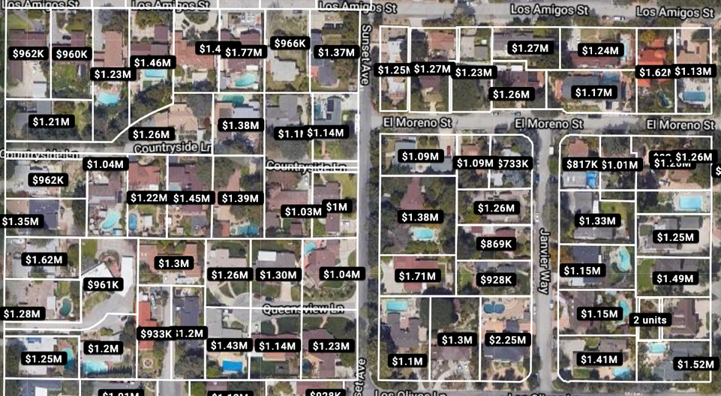


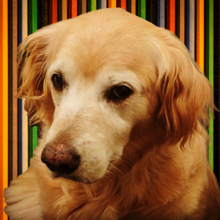
What are spatial AI methods?
Machine learning & data mining methods generally assume independent and identically distributed random variables – i.i.d.
But spatial data are not i.i.d.
Auto-correlation
Nearby things are similar
Spatial non-stationarity
Models are difficult to generalize
And more…
How do we use these unique spatial data properties to improve machine learning models?
Bob is going to help us summarize the presentation along the way!
Air quality near highway I-394 can be very different depending on their locations
Nearby houses have similar prices
Notes:
Too complicated

Slide 3
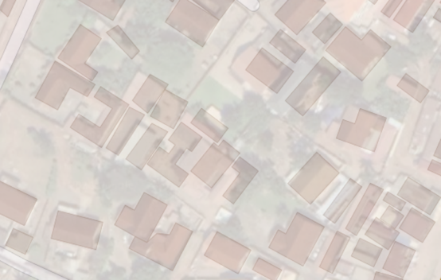
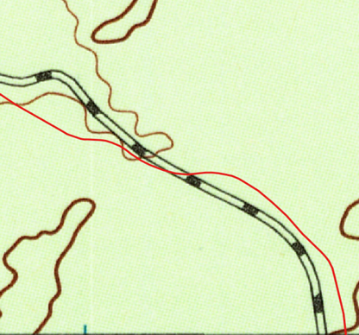

Why do we care?
Location is the key to link various types of data
e.g. can provide context-rich annotated (training) data (if we do it correctly)
Positional offsets: buildings are not aligned
&
Content inconsistency:
One building vs. multiple
“By using the data in OSM, we were able to collect more than 100 million labeled examples to add to our training data set.”
“However, using OSM data for labels presented several challenges that required novel approaches to overcome.”
Facebook Map with AI
USGS Railroads
Data scale/representation conflict
USGS historical topo. map
https://ai.facebook.com/blog/mapping-the-world-to-help-aid-workers-with-weakly-semi-supervised-learning/
Label road locations on imagery with OpenStreetMap data

Slide 4
What are we building?
Health
Transportation
Social Sciences
Impact: Tech. Transfer &
Open Source Tools In-Use
Real-World Problems & Data
End-to-End Data Analytics Systems
DeepLATTE: Air Quality Prediction & Forecasting Framework
Strabo & mapKurator: Map Processing Platform
ADMS: Transportation Data Analytics Platform (joint work with USC IMSC)
…
Fundamental Research
ACM SIGSPATIAL, ACM KDD, IEEE International Conference on Data Mining, IEEE BigData, IEEE Mobile Data Management, Extended Semantic Web Conference, International Journal of Geographical Information Science, Knowledge-Based Systems

Slide 5
Building Autocorrelation-Aware Representations for Fine-Scale Air Quality Prediction
Lin et al., 2020 (IEEE International Conference on Data Mining)

Slide 6
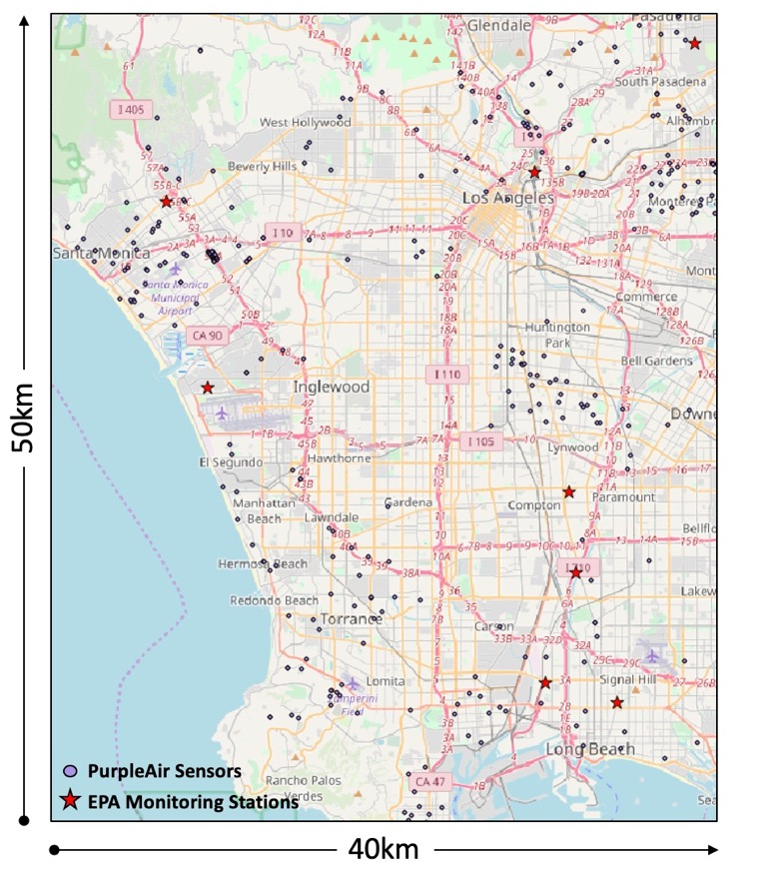
Motivation
Traditional spatial interpolation methods (e.g., IDW – inverse distance weighting, Kriging) produce smooth results over the space.
Air quality monitoring locations are limited and unevenly distributed.
The air quality in the entire city of Los Angeles is the same everywhere?! That can’t be right.
https://airnow.gov/

Slide 7

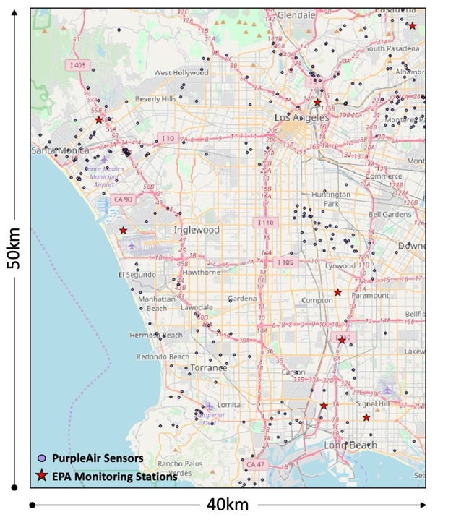
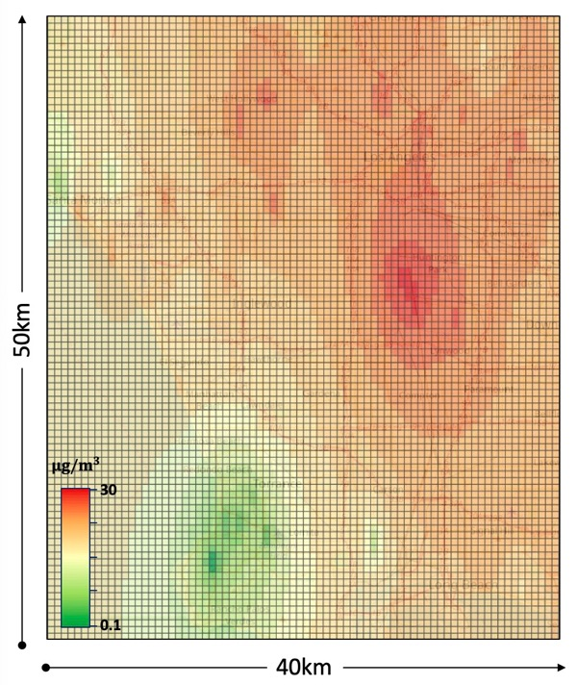




Not suitable for exposure tracking
IDW Prediction
PM2.5
Spatial interpolation methods do not reflect local PM2.5 spatial variations!
Time
PM2.5
Time

Slide 8
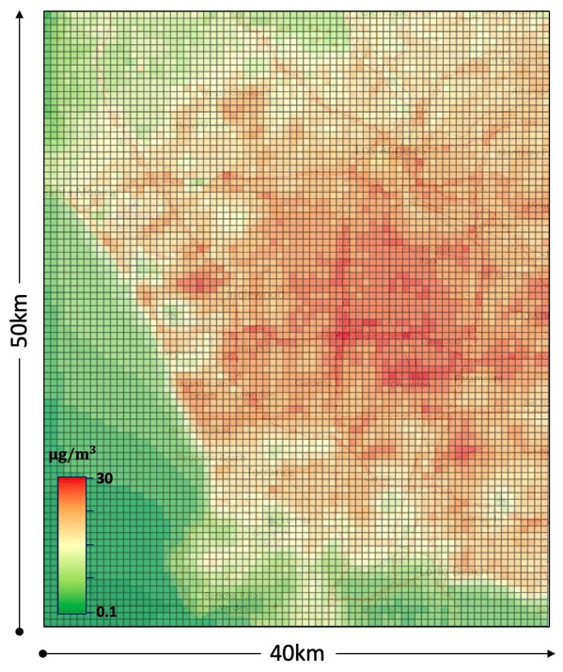


What we need:
Air quality prediction that reflect the environment impact
PM2.5
Fine-scale predictions help me track accurate PM2.5 exposure from my daily walks!
Time
PM2.5
Time

Slide 9
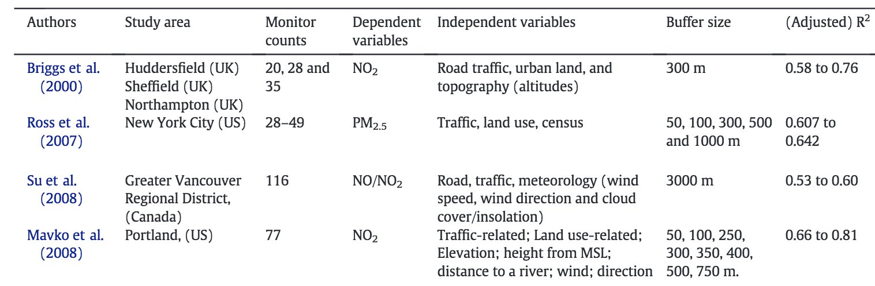
Hypothesis
Environmental characteristics significantly impact air quality (e.g., PM2.5)
Source: [Liu et al., 2016]
Notes:
The number of labeled data is much smaller than the number of unlabeled data
The environment characteristics of labeled locations are limited to learn
The model might only focus on the labeled data, which leads to inaccuracy in the prediction results

Slide 10
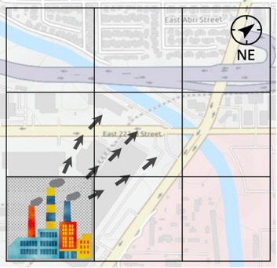
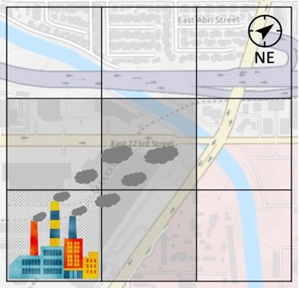
Challenges
Existing approaches either require expert knowledge or does not deal with space and time together and cannot handle sparse and unevenly distributed observations
(e.g., [Briggs et al. 1997; Zheng et al. 2013; Liu et al., 2016; Lin et al. 2017])
How to learn from thousands of features describing the environmental characteristics with only sparse and unevenly distributed observations
How to jointly model spatiotemporal effects
Wind blowing towards North East
9 am
10 am
Notes:
The number of labeled data is much smaller than the number of unlabeled data
The environment characteristics of labeled locations are limited to learn
The model might only focus on the labeled data, which leads to inaccuracy in the prediction results

Slide 11
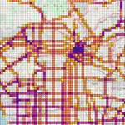
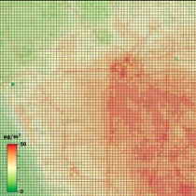

We build DeepLATTE
Learn from thousands of features describing the environmental characteristics
Learn to jointly model spatiotemporal effects
Learn from sparse and unevenly distributed observations
Feature
Selection
Jointly Learning Spatiotemporal Effects
Enforcing Local Embeddings to be Similar
Enforcing Autocorrelation Pattern
Road length
… …
Creating initial environmental characteristics embeddings
Leveraging spatial properties to improve embeddings
Temperature
Notes:
The number of labeled data is much smaller than the number of unlabeled data
The environment characteristics of labeled locations are limited to learn
The model might only focus on the labeled data, which leads to inaccuracy in the prediction results

Slide 12
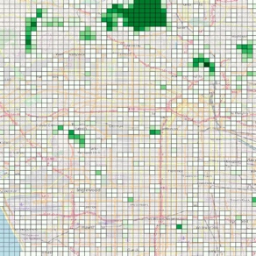
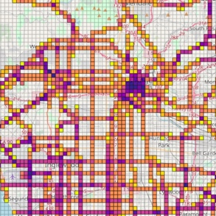
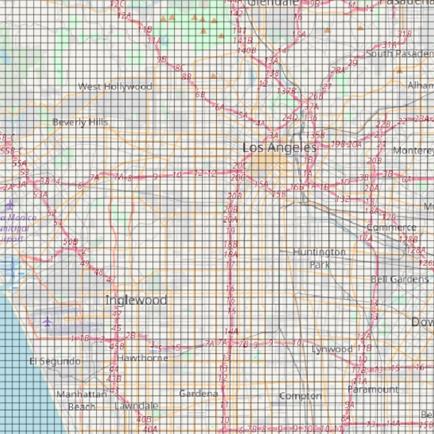
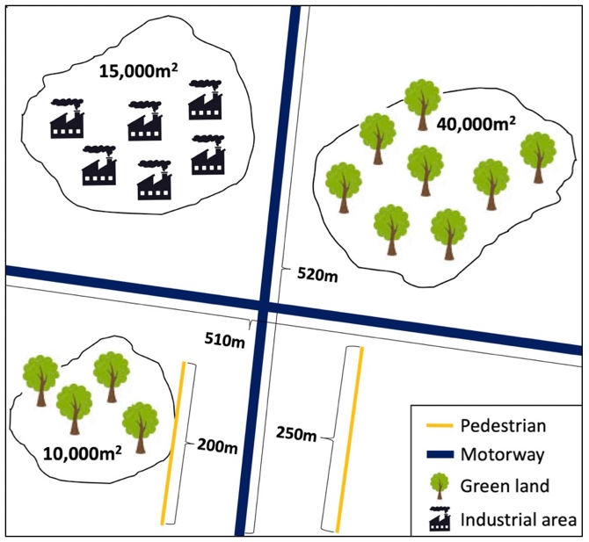
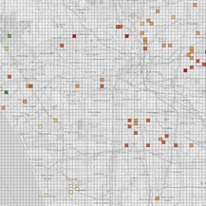


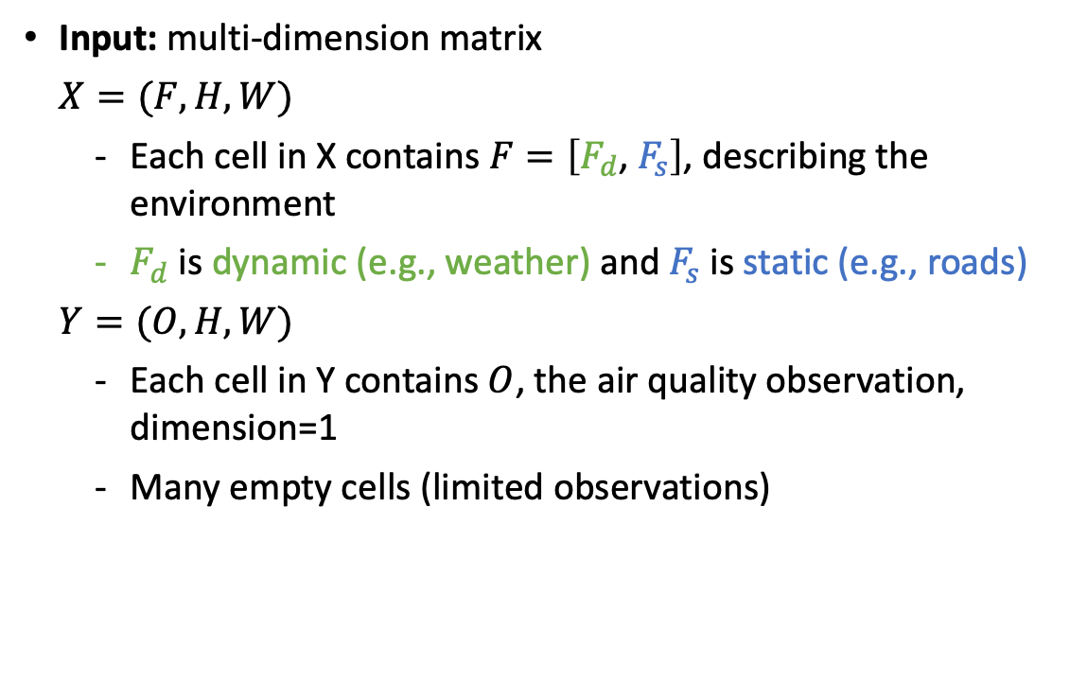
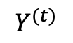
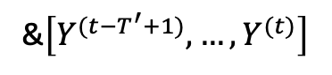
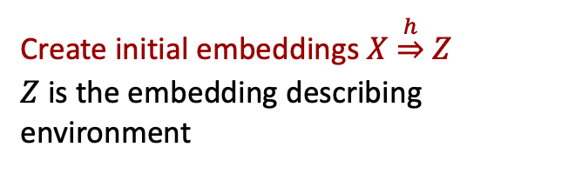
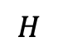
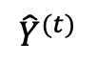

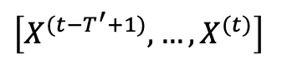
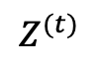
Formally
Area(Industry)
Len(Primary Roads)
…
Humidity
Temperature
Green land
Primary road
Input: multi-dimension matrix
$X=(F,H, W)$
Each cell in X contains $F=\left[F_{d}\text{,} { F}_{s}\right]$, describing the environment
$F_{d}$ is dynamic (e.g., weather) and $F_{s}$ is static (e.g., roads)
$Y=(O, H, W)$
Each cell in Y contains $O$, the air quality observation, dimension=1
Many empty cells (limited observations)
$$H$$
Grid Map
$$W$$
$\left[X^{(t−T^{′}+1)}, …, X^{(t)}\right]$
&$\left[Y^{(t−T^{′}+1)}, …, Y^{(t)}\right]$
Create initial embeddings $X$ $\underset{⇒}{h}$ $Z$
$Z$ is the embedding describing environment
$$Z^{(t)}$$
$$\text{Exploit} \text{spatial} \text{data} \text{properties} \text{to} \text{refine} Z$$
$$Y^{(t)}$$
$${\hat{Y}}^{(t)}$$
Make prediction!
Notes:
similarity($z_{i}$,${ z}_{j}$) $\underset{⇒}{f}$ similarity(${\hat{y}}_{i}$, ${\hat{y}}_{j}$)

Slide 13
We build DeepLATTE (recap)
Learn from thousands of features describing the environmental characteristics
Learn to jointly model spatiotemporal effects
Learn from sparse and unevenly distributed observations
Feature
Selection
Jointly Learning Spatiotemporal Effects
Enforcing Local Embeddings to be Similar
Enforcing Autocorrelation Pattern
Road length
… …
Creating initial environmental characteristics embeddings
Leveraging spatial properties to improve embeddings
Temperature
Notes:
The number of labeled data is much smaller than the number of unlabeled data
The environment characteristics of labeled locations are limited to learn
The model might only focus on the labeled data, which leads to inaccuracy in the prediction results

Slide 14
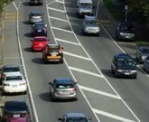
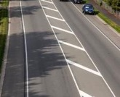
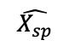
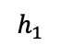

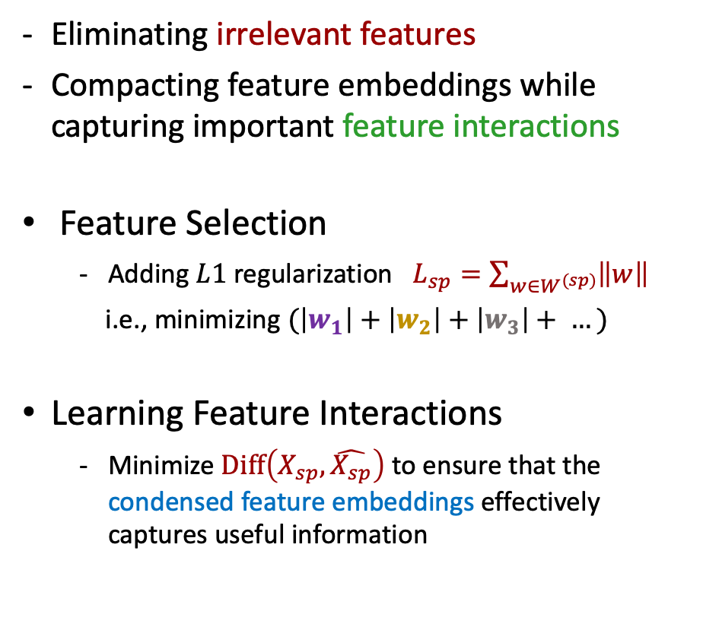
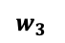
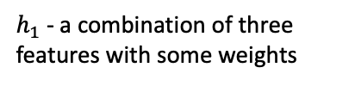
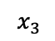
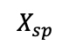
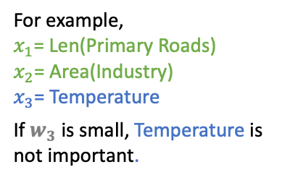
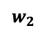
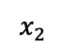
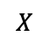
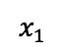
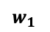
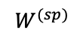


Feature selection and compacting
Eliminating irrelevant features
Compacting feature embeddings while capturing important feature interactions
Feature Selection
Adding $L1$regularization $L_{sp}=\sum_{w∈W^{(sp)}}{\left\|w\right\|}$
i.e., minimizing $(\left|w_{1}\right|+\left|w_{2}\right|+\left|w_{3}\right|+ …)$
Learning Feature Interactions
Minimize $Diff\left(X_{sp},\hat{X_{sp}}\right)$ to ensure that the condensed feature embeddings effectively captures useful information
Sparse Layer
Auto-Encoder
$$x_{1}$$
$$w_{1}$$
Monday
Sunday
$$w_{2}$$
$$x_{2}$$
For example,
$x_{1}$= Len(Primary Roads)
$x_{2}$= Area(Industry)
$x_{3}$= Temperature
If $w_{3}$ is small, Temperature is not important.
Static Features
Encoder
Decoder
For example,
$$w_{3}$$
$$x_{3}$$
Len(Primary Roads)
Dynamic Features
$w_{1}$
Area(Industry)
$w_{2}$
$$h_{1}$$
Day of Week
$w_{3}$
$$X$$
$$W^{(sp)}$$
$$X_{sp}$$
$$\hat{X_{sp}}$$
$h_{1}$ - a combination of three features with some weights
Notes:
Basically, the layer would be a sparse layer like this, each input feature would be connected singly to the node in the next layers with some weights. We try to

Slide 15
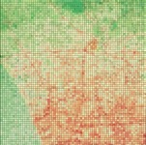
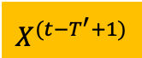
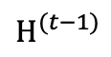
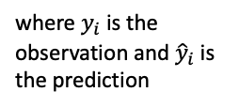
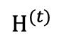
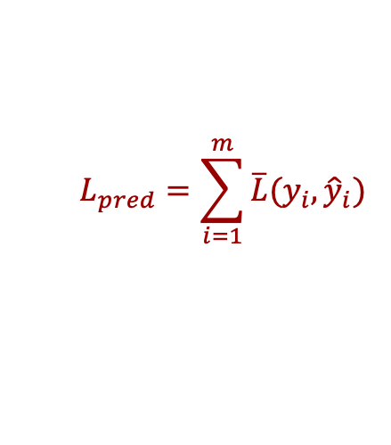


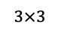
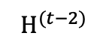

Learning Spatiotemporal Effects
Capture spatiotemporal effects: current air quality is correlated with the environmental characteristics now, in the past, and from neighboring locations.
Conv-LSTM layer (Shi et al., 2015)
Add the convolution operation directly in the recurrent neural network
where $y_{i}$is the observation and ${\hat{y}}_{i}$is the prediction
Compacted representation of environmental characteristics at each time
CNN (Convolutional Neural Network)
LSTM (Long Short Term Memory), a Recurrent Neural Network
$$L_{pred}=\sum_{i=1}^{m}{\overline{L}(y_{i},{\hat{y}}_{i})}$$
$$X^{(t−T^{′}+1)}$$
$$X^{(t−1)}$$
$$X^{(t)}$$
$$H^{(t−T^{′}+1)}$$
$$H^{(t−2)}$$
$$H^{(t−1)}$$
$$H^{(t)}$$
LSTM Cell
LSTM Cell
LSTM Cell
Embedding
$$3×3$$
Convolution operations within each LSTM cell
Hidden information from previous times
Predictions

Slide 16
Are we done yet…
Can compact features and capture important feature interactions
Can capture spatiotemporal effects
But we only have sparse and unevenly distributed observations
limited variations of environmental characteristics in the training data
Feature
Selection
Jointly Learning Spatiotemporal Effects
Enforcing Local Embeddings to be Similar
Enforcing Autocorrelation Pattern
Next
Done
Done
Road length
… …
Creating initial environmental characteristics embeddings
Leveraging spatial properties to improve embeddings
Temperature
Notes:
The number of labeled data is much smaller than the number of unlabeled data
The environment characteristics of labeled locations are limited to learn
The model might only focus on the labeled data, which leads to inaccuracy in the prediction results

Slide 17



Sparse & unevenly distributed observations
Sparse & unevenly distributed observations make the model focus on the labeled locations
Learned predictions focus on a few locations can fluctuate within a small distance, e.g., 1,000m
The model has too many unseen locations!
$P$ - Predictions

Slide 18

Use spatial data properties to our advantage
Tobler's First Law of Geography: Everything is related to everything else, but near things are more related than distant things.
Location B
Air quality at location B
>
Location A
Nearby
Air quality at location A

Slide 19

















Use Tobler’s first law of geography
Enforcing spatially and temporally neighboring embeddings to be similar
i.e., environmental characteristics change gradually in space and time
Time
Same location at different times
Loc $i$
$E_{i}^{(t)}$ $≈$ $E_{i}^{(j)}$
$$j∈\left\{t−1, …,{t−K}_{T}\right\}$$
Minimizing the Euclidean distance of ${(E}_{i}, E_{j})$
(${t−K}_{T}$)
($t−1$)
($t$)
Space
Same time at different locations
$E_{i}^{(t)}$ $≈$ $E_{j}^{(t)}$
$$j∈\left\{𝒩_{i}^{1}, …,𝒩_{i}^{K_{s}}\right\}$$
($t$)
One step neighbors $𝒩_{i}^{1}$
$K_{s}$ step neighbors $𝒩_{i}^{K_{s}}$

Slide 20


Use Tobler’s first law of geography
Enforcing spatially and temporally neighboring embeddings to be similar
i.e., environmental characteristics change gradually in space and time
BUT this only benefits dense and evenly distributed sensor networks. In practice, most sensors do not have nearby neighbors.
Same location at different times
$E_{i}^{(t)}$ $≈$ $E_{i}^{(j)}$
$$j∈\left\{t−1, …,{t−K}_{T}\right\}$$
Minimizing the Euclidean distance of ${(E}_{i}, E_{j})$
Same time at different locations
$E_{i}^{(t)}$ $≈$ $E_{j}^{(t)}$
$$j∈\left\{𝒩_{i}^{1}, …,𝒩_{i}^{K_{s}}\right\}$$
South Coast AQMD Monitors
https://gispub.epa.gov/airnow/
PurpleAir Sensors
https://www2.purpleair.com/
(50km×40km geographic area)

Slide 21
Extend Tobler’s first law of geography
Enforcing neighboring embeddings to have similar air quality
Nearby locations have similar air quality implies locations with a similar “environment” have similar air quality
Embedding
Can we learn how to quantify how distance similarity implies environment similarity and then air quality similarity?
Embedding
Location semantic at location B
>
Embedding
Location semantic at location A
>
>

Slide 22





Learning autocorrelation pattern in the embedding space
Embeddings
First, quantifying the spatial autocorrelation pattern that nearby embeddings have a similar air quality
Use a spatial statistical method – Kriging
>
>
In Kriging-like methods, we use geographic distance
$${\left\|E_{i}−E_{j} \right\|}_{2}∈\left[0.1, \left.0.2\right) (embedding distance)\right.$$
Example Embedding Space
Semivariance Computation
$$\frac{1}{2×2}\left({\left(Y( )−Y( )\right)}^{2} \text{+}{ \left(Y( )−Y( )\right)}^{2}\right)$$
Air quality semivariance
where $Y\left(E\right)$ is the air quality value (label) of embedding$E$
For every distance lag (bin), computing the semivariance, $γ\left(h\right)$
$$γ\left(h\right)=\frac{1}{2N(h)}\sum_{i}{\sum_{j≠i}{{\left(Y\left(E_{i}\right)−Y\left(E_{j}\right)\right)}^{2}}}$$
Embedding similarity bins (distance lag)
where $N(h)$ is the number of pairs in a bin
($h$)

Slide 23

Learning autocorrelation pattern in the embedding space
First, quantifying the spatial autocorrelation pattern that nearby embeddings have a similar air quality
Use a spatial statistical method – Kriging
Quantify the embedding autocorrelation with a kernel function
The kernel function tells us: 1) within an influence range, two nearby embeddings would have similar air quality; 2) theoretically how embedding distance implies air quality similarity (the dashed blue line)
Strong autocorrelation
Little autocorrelation
Air quality semivariance
“Influence Range”
kernel function
Embedding similarity bins (distance lag)
($h$)

Slide 24









Enforcing autocorrelation to refine embeddings
Embeddings
>
Predictions should have a similar autocorrelation pattern as the observations within the influence range
i.e., the purple (observation) and green (prediction) dashed lines (indicating the autocorrelation strength) should be similar
Represent pairwise embedding distances in each bin as a Gaussian distribution
Minimizing $\sum_{h}{D_{KL}(𝒩(μ_{y_{h}},σ_{y_{h}})||𝒩(μ_{{\hat{y}}_{h}},σ_{{\hat{y}}_{h}}))}$
Encourage the network to learn from unlabeled locations since we can describe each location with an embedding!
Air quality semivariance
Observed ${{(y}_{i}−y_{j})}^{2}$
Observed $𝒩\left(μ_{y},σ_{y}\right)$
Predicted${{ (\hat{y}}_{i}−{\hat{y}}_{j})}^{2}$
Predicted $𝒩\left( μ_{\hat{y}},σ_{\hat{y}}\right)$
($h$)
Embedding similarity bins (distance lag)

Slide 25
Put everything together
Spatial and Temporal Space
Embedding Space
Feature
Selection
Jointly Learning Spatiotemporal Effects
Enforcing Local Embeddings to be Similar
Enforcing Autocorrelation Pattern
Road length
… …
Creating initial environmental characteristics embeddings
Leveraging spatial properties to improve embeddings
Temperature
Total Loss = Loss[Trainin Total Loss = 𝛼 × Loss[Sparse Layer] + 𝛽 × Loss[Auto-Encoder]
+ 𝛾 × Loss[Local Autocorrelation] + 𝜂 × Loss[Global Autocorrelation]

Slide 26

Experiment settings
Gridded Space
Create a grid surface with cell size 500m×500m
- 50km×40km in Los Angeles
Input Data
Air quality data: PurpleAir
hourly PM_{2.5} measurements (2018)
Meteorological data: DarkSky
hourly weather information, e.g., temperature, visibility, pressure, humidity
Geographic data: OpenStreetMap
82 features, e.g., length(primary roads), area(green land), count(hotels)
Other features: hour of day, day of week, day of year, longitude and latitude

Slide 27


Experiment settings
Training settings
Dividing the area into four parts, each selecting randomly 60% locations for training, 20% for validation, and 20% for testing
Ensure similar spatial distribution of the training data and validation data
A
B
C
D
Notes:
In sample
Out of sample (space and temporal)
2018 training 2019 testing

Slide 28

Quantitative analysis
Built one predictive model per month
DeepLATTE (red line) outperformed all baseline methods in RMSE and R2
Ablation studies
Without the feature selection module underperforms 1.8%-5.1% in RMSE
Without learning autocorrelation underperforms 4.1%- 8.3% in RMSE
Our 2017 model
DeepLATTE
But, for the locations that do not have a ground observation, how do we know we are correct?
RMSE

Slide 29




Evaluating geo-features
Evaluating the relationships between predictions and geographic features
Showing the result in Oct. 2018, i.e., computing monthly average
(m) | Motorway | Light Rail
0 | 16.9374 | 17.2880
Distance <= 500 | 16.7656 | 17.1838
Distance <= 1,000 | 16.6616 | 17.0828
Away from major transportation networks improve air quality
Predictions
Motorway
(m) | Park
0 | 16.4163
Distance > 500 | 16.6054
Distance > 1,000 | 17.0344
Close to parks improve air quality
Light Rail
Parks

Slide 30








Visualizing hourly average prediction patterns
Same-scale legend
For each grid, computing the hourly average over a year
20
18
16
Midnight
3AM
6AM
9AM
14
12
10
8
0
5
10
15
20
Large temperature differences in a day create a thick layer in the air preventing PM2.5 to escape
12PM
3PM
6PM
9PM
Notes:
(showing predictions of random 30 locations in the time-series)

Slide 31




Spatial Visualizations Monthly Average Predictions
Griffith Park
Intersection of 110 and 10
105
110
710
Feb. 2019, Our Model
Feb. 2019, Ordinary Kriging
Oct. 2019, Our Model
Oct. 2019, Ordinary Kriging
EXPERIMENT | 31
Notes:
Kenneth Hahn State Recreation Area

Slide 32


Spatial Visualizations Monthly Average Predictions
Griffith Park
Griffith Park
Intersection of 110 and 10
105
110
710
Golf Course
Feb. 2019, Our Model
Feb. 2019, Universal Kriging
Oct. 2019, Our Model
Oct. 2019, Universal Kriging
* Universal Kriging can leverage covariates (e.g., temperature) to estimate a trend in the spatial process
EXPERIMENT | 32
Notes:
Kenneth Hahn State Recreation Area

Slide 33
Evaluating selected dynamic features
Selected dynamic features (10 out of 14), Oct. 2018 monthly average
Visibility
Day of week
Dew point
Day of year
Temperature
Wind speed
Wind direction
Cloud cover
Pressure
Hour of day
“Atmospheric visibility has been found to correlate well with PM2.5 concentrations” [Zhang et al. (2006)]
Dynamic Features | Pearson Correlation with Predictions
Visibility | -0.7395
Dew point | 0.3070
Temperature | -0.2417
Wind speed | -0.2608
Wind direction | 0.1794
Cloud cover | 0.25413
Pressure | -0.0613

Slide 34
Evaluating selected static features
Selected static features (21 out of 84, showing top 12)
Latitude
Longitude
Land use: commercial
Roads: motorway
Traffic: stops
Land use: residential
Traffic: fuel
Roads: secondary
Roads: service
Waterways: river
Railways: light rail
Railways: rail
Moore et al. show that industrial areas, arterial roads, open areas are statistically significantly associated with PM2.5 in Los Angeles (R-value is approximately 0.4 to 0.6 respectively) using LUR approach.
Kam et al. demonstrated that the light-rail lines and subways are strongly associated with ambient PM levels in Los Angeles (R2=0.61) by personally monitoring the air quality at the stations.

Slide 35
Summary
Presented a novel spatial-enabled machine learning approach that predicts fine-scale air quality, support interpretable results
Future Work
Apply our model to other location-dependent time-series data, e.g., remotely sensed thermal imagery over time
Improve the interpretability (the selected features)
Model the uncertainty in the contextual data
Improve handling the spatial non-stationarity problem

Slide 36
Generating Linked Historical Maps
Li et al. KDD (2020)

Slide 37



Why historical maps?
How can we find relevant maps and make them useful if manual metadata curation is not possible?
Existing data sources typically contain only contemporary datasets, e.g., present place names
Thousands of historical maps contain detailed geographic information at various times in the past
Most of the historical maps are usually just scanned images with limited metadata

Slide 38

Text on maps are useful but complex
OCR (optical character recognition) tools, such as Google Vision API, would only generate “Fall” and “River” but not “Fall River”

Slide 39


Generating linked historical maps
Map Image
Mindego Creek
La Honda
Skyline Ridge
…
Black Mountain
Location Phrase Generation
Map Geo
localization
A fully automatic pipeline!
Entity Matching
Linked Historical Maps
Linked
External KBs: LinkedGeoData

Slide 40




Generating location phrases
Textual Model: Labels in the same phrase should share similar textual features
High Recall/Low Precision
Help to determine a search neighborhood
Visual Model: Labels in the same phrase could have similar nearby geographic features
Low Recall/High Precision
Help to refine the results
…
U-Net semantic segmentation

Slide 41

Geolocalization using location phrases
We use Google Geocoding API as the geo-coder: text to lat/long
Geo-coder
Clustering
Location Phrases
List of Candidate Coordinates
(34.25, -116.18)
DBScan
Mindego Creek
Providence Mountains
Cooks Wall
Clipper Mountain
…
…
Banana Spring
Mindego Creek
(36.77, -119.48)
(36.54, -119.72)
…
Providence Moutains
(38.72, -120.53)
(36.74, -119.42)
…
The cluster center of the largest component is the map geolocalization result.

Slide 42







Entity linking using map geolocation
Entity Matching
Georeferenced Location Phrases
Match name and location
“Black Mountain” on this map is now linked to an OSM node with all kinds of extra metadata!
Mindego Creek
Providence Mountains
Cooks Wall
Clipper Mountain
…
…
Banana Spring
(34.25, -116.18)

Slide 43
Experimental setting and metrics
Datasets
United States Geological Survey maps (USGS)
15 maps with 4,375 text regions and locations
Ordnance Survey maps (OD)
10 maps with 2,197 text regions
New York Public Library maps (NYPL)
500 maps without annotated text regions but with locations
Crowdsourced by NYPL

Slide 44

Geolocalization results for small dataset
Geocoding using individual words and then spatial clustering
Geocoding using individual phrases and then spatial clustering
Geocoding using all text as a paragraph
USGS dataset contains 15 images, we used 12 for training and 3 for testing.
If smaller than 1, the map image covers the predicted geocoordinates

Slide 45
Geolocalization results for large dataset
NYPL dataset contains 500 images.

Slide 46


Summary with a query sample
More than just keyword search!
Sample query: search for historical maps that contain mountains higher than 1,000 meters

Slide 47


Ongoing: Object detection with weak annotation
Object detection with limited training data
Blue area –wetland boundaries from the United States Geological Survey
Identified locations of wetland symbols
Green: true positives
Red: false Positives
Scanned historical map

Slide 48




Results visualizations (cars)
We know there are many target objects within the boundary
Spatial auto-correlation
Spatial co-occurrence of cars and parking lots
But we only have one sample…
Build a generative model to learn a more “relaxed” representation (a distribution) than descriptive models
So that we can iteratively improve the representation when we find more objects like the target sample

Slide 49


Ongoing: Detecting Trajectory Moving Behaviors Limited and Uncertain Contextual Data
Manual labeling is expensive
Various spatial & temporal scales in the trajectories
Geographical context can be incomplete

Slide 50



Ongoing: Encoding the World’s Geospatial Data

Slide 51
Overall summary
And many, many other real-world applications that need the investigation of fundamental computer & spatial science research to solve!
We can exploit spatial and temporal relationships across data to create large amounts of information-rich contextual data
We can use the contextual data to enable many types of analytics about spatial things, e.g.,
Predicting fine-scale air quality
Detecting objects from geo-Images using weakly annotated data
Geolocating and linking scanned map images with external knowledge bases

Slide 52


Acknowledgement
Stefan Leyk, Johannes Uhl (CU Boulder)
Yijun Lin, Weiwei Duan, Zekun Li, Jina Kim, Jose Luis Ambite, Craig Knoblock, Hayley Song, Dan Feldman (USC CS), Meredith Franklin, Sandy Eckel (USC Keck Medical School)
Sasan Tavakkol (Google AI)

Slide 53
Want to learn more?

Slide 54
CSCI 5980/8980 (Spring 2022) Spatial Enabled Artificial Intelligence
Introduction to Spatial AI
Spatial Data Representation and Management
PostGIS, GeoMesa
Semantic Web, Ontology, Knowledge Graph
Introduction to Spatial Statistics
Introduction to Deep Learning Methods for Handling:
Spatial Natural Language Data
Spatial Image Data
Spatial Time-series Data

Slide 55
Course Load
Some quizzes
A few programming assignments to get you familiar with the materials
Final project
MS/Senior Undergrad
A comparison of selected state-of-the-art methods for solving a spatial AI problem (e.g., object detection from satellite imagery)
MS/PhD
Develop a complete research work, which could be related to your research direction

Slide 56

Are you Okay?
Sofa so good!

Slide 57

Natural Language Data (Natural Language Processing)
“Bank” in “River Bank of the Mississippi” vs “Bank of America”
in Los Angeles, a “ramp” often refers to a highway entrance or exit, but a ramp is colloquially known as a covered parking structure without walls in Minneapolis. Therefore, the sentence “I parked my Honda Civic on the Oak Street ramp.” would have very different implications (for the two cities) that are difficult to capture using only text corpora.

Slide 58


Slide 59


Image Data (Computer Vision)

Slide 61






Time-Series Data

Slide 63
Historical Map Processing I: Object Detection with Weak Annotation
Selected Publications: Chiang et al., 2014 (ACM Computing Survey); Uhl et al., 2017 (International Conference on Pattern Recognition Systems, Best Paper Award) Chiang et al., 2015 (SIGSPATIAL, Best Vision Paper Award); Tavakkol et al., 2019 (GeoAI); Shbita et al., 2019 (Extended Semantic Web Conference ); Chiang et al., 2019 (Springer Brief); Duan et al., 2021 (Submit to ICCV)

Slide 64


Why Historical Maps?
How can we find relevant maps and make them useful if manual metadata curation is not possible?
Existing data sources typically contain only contemporary datasets, e.g., present place names
Maps contain detailed geographic information at various times in the past
Most of the historical maps are usually just scanned images with limited metadata

Slide 65


Make Historical Map Useful
Object detection from geo-images with limited training data
Blue area –wetland boundaries from the United States Geological Survey
Identified locations of wetland symbols
Green: true positives
Red: false Positives
Scanned historical map

Slide 66






Problem Definition
Input: Geo-image
Input: Parking lot boundaries
Input: One sample of the target object
Output: Identified target objects within the boundaries
Green: target class
Others: non-target class
Use a sliding window in the boundaries to crop image patches
Generative Model for Two-Class Clustering
Notes:
Update generative model

Slide 67




Challenges
The target object can have
Transformational variance
Diverse visual appearance
No training data for non-target categories

Slide 68

Why Generative Model?
We know there are many target objects within the boundary
Spatial auto-correlation
Spatial co-occurrence of cars and parking lots
But we only have one sample…
Generative models help to learn a more “relaxed” representation (a distribution) than descriptive models
So that we can iteratively improve the representation when we find more objects like the target sample
Notes:
Update generative model

Slide 69



Generative Model using Weak Annotations
We want to model p(x, z, y): X is the observed data (target sample with augmentation), Z is the hidden variable, Y is the class label (e.g., car vs. others)
Assume:
$$\text{p}\text{(}\text{x}\text{) =}\sum_{y}{\int_{z}{\text{p}\text{(}\text{x}\text{, }\text{z}\text{, }\text{y}\text{) =}\sum_{y}{\int_{z}{\text{p}\text{(}\text{x}\text{|}\text{z}\text{,}\text{y}\text{)}\text{p}\text{(}\text{z}\text{|}\text{y}\text{)}\text{p}\text{(}\text{y}\text{)}}}\text{, }}}$$
p(y): a categorical distribution with two categories and a prior [0.5, 0.5]
p(z|y): Gaussian distributions; p(x), p(z): MoG (Mixtures of Gaussian)
Use variational inference (under mean field assumptions), we can maximize the likelihood, p(x):
by maximizing the following terms, evidence lower bound (ELBO):
That’s a lot of math, and you skip many steps! How are these colorful terms useful? What do they mean?
For target samples (y=1 is the target class)
$$ℒ\left(x_{t}\right)=\log{p\left(x_{t} | z\right)}−\int_{z}{\left[log q\left(z | x_{t},y=1\right)−log p\left(z | y=1\right)\right]dz}$$
For unlabeled samples (y can be 1 or 0)
$$ℒ\left(x_{u}\right)=\sum_{y}{q(y|x_{u})}log p\left(x_{u} | z\right)−\sum_{y}{q\left(y | x_{u}\right)}\int_{z}{\left[log q\left(z | x_{u},y\right)−log p\left(z | y\right)\right]dz}−KL\left[q\left(y | x_{u}\right)∥p\left(y\right)\right]$$

Slide 70














Variational Auto-Encoder
Fully Connected Layers
SofaMax Function
Fully Connected Layers
$$N\left(μ_{z}^{u;c[0,1]},σ_{z}^{u;c[0,1]} \right)$$
$$N\left(μ_{z′}^{c[0,1]},σ_{z′}^{c[0,1]} \right)$$
Encoder
Decoder
…
$$c\left[p_{c1},p_{c2}\right]$$
$$c\left[0,1\right]$$
$$c\left[1,0\right]$$
$$N\left(μ_{z}^{u;c[1,0]},σ_{z}^{u;c[1,0]} \right)$$
$$N\left(μ_{z′}^{c[1,0]},σ_{z′}^{c[1,0]} \right)$$
$$N\left(μ_{z}^{t;c[1,0]},σ_{z}^{t;c[1,0]} \right)$$
$$x_{u}^{\left(1\right)}$$
…
…
Reconstruction Error
MSE${(x}_{t}^{\left(1\right)}, {\hat{x}}_{t;c[1,0]}^{\left(1\right)})+p_{c1} ×$MSE${(x}_{u}^{\left(1\right)}, {\hat{x}}_{u;c[0,1]}^{\left(1\right)})+p_{c2} × \text{MSE}{(x}_{u}^{\left(1\right)}, {\hat{x}}_{u;c[1,0]}^{\left(1\right)})$
Cluster label Prior
CrossEntropy$\left(c\left[p_{c1},p_{c2}\right], \left[0.5,0.5\right]\right)$
Conditional VAE
$p_{c1} ×$KL$\left[N\left(μ_{z}^{u;c\left[0,1\right]},σ_{z}^{u;c\left[0,1\right]} \right)∥N\left(μ_{z^{′}}^{c\left[0,1\right]},σ_{z^{′}}^{c\left[0,1\right]} \right)\right]+$
$p_{c2} ×$KL[$N\left(μ_{z}^{u;c[1,0]},σ_{z}^{u;c[1,0]} \right)∥N\left(μ_{z^{′}}^{c\left[1,0\right]},σ_{z^{′}}^{c\left[1,0\right]} \right)]+$
KL[$N\left(μ_{z}^{t;c[1,0]},σ_{z}^{t;c[1,0]} \right)∥N\left(μ_{z^{′}}^{c\left[1,0\right]},σ_{z^{′}}^{c\left[1,0\right]} \right)]$
Directly predict class label from unlabeled image
Directly predict the hidden distribution from class labels
$$x_{u}^{\left(1\right)}+c\left[0,1\right]$$
$$x_{u}^{\left(1\right)}+c\left[1,0\right]$$
$$x_{t}^{\left(1\right)}+c\left[1,0\right]$$
$${\hat{x}}_{u;c[0,1]}^{\left(1\right)}$$
$${\hat{x}}_{u;c[1,0]}^{\left(1\right)}$$
$${\hat{x}}_{t;c[1.0]}^{\left(1\right)}$$
Weighted errors:
${ p}_{c1}$ and $p_{c2}$ are the predicted probability of the class labels
One forward pass
$$x_{u}^{\left(2\right)}+c\left[0,1\right]$$
$$x_{u}^{\left(2\right)}+c\left[1,0\right]$$
$$x_{t}^{\left(2\right)}+c\left[1,0\right]$$
$${\hat{x}}_{u;c[0,1]}^{\left(2\right)}$$
$${\hat{x}}_{u;c[1,0]}^{\left(2\right)}$$
$${\hat{x}}_{t;c[1.0]}^{\left(2\right)}$$
An image patch padded with one-hot class labels
…
…

Slide 71




Put Math Together with the Neural Networks
Generative process guided by the target sample(s) and class predictions
Class prediction
determines the weights for the loss terms for unlabeled samples
encourages correct class predictions during training
For target samples
$$ℒ\left(x_{t}\right)=\log{p\left(x_{t} | z\right)}−\int_{z}{\left[log q\left(z | x_{t},y=1\right)−log p\left(z | y=1\right)\right]dz}$$
Maximizing the ELBO terms
For unlabeled samples
$$ℒ\left(x_{u}\right)=\sum_{y}{q(y|x_{u})}log p\left(x_{u} | z\right)−\sum_{y}{q\left(y | x_{u}\right)}\int_{z}{\left[log q\left(z | x_{u},y\right)−log p\left(z | y\right)\right]dz}−KL\left[q\left(y | x_{u}\right)∥p\left(y\right)\right]$$
Reconstruction Error
MSE${(x}_{t}^{\left(1\right)}, {\hat{x}}_{t;c[1,0]}^{\left(1\right)})+p_{c1} ×$MSE${(x}_{u}^{\left(1\right)}, {\hat{x}}_{u;c[0,1]}^{\left(1\right)})+p_{c2} × \text{MSE}{(x}_{u}^{\left(1\right)}, {\hat{x}}_{u;c[1,0]}^{\left(1\right)})$
Cluster label Prior
CrossEntropy$\left(c\left[p_{c1},p_{c2}\right], \left[0.5,0.5\right]\right)$
Conditional VAE
$p_{c1} ×$KL$[N\left(μ_{z}^{u;c\left[0,1\right]},σ_{z}^{u;c\left[0,1\right]} \right)∥N\left(μ_{z^{′}}^{c\left[0,1\right]},σ_{z^{′}}^{c\left[0,1\right]} \right)]+p_{c2} ×$KL[$N\left(μ_{z}^{u;c[1,0]},σ_{z}^{u;c[1,0]} \right)∥N\left(μ_{z^{′}}^{c\left[1,0\right]},σ_{z^{′}}^{c\left[1,0\right]} \right)]+$
KL[$N\left(μ_{z}^{t;c[1,0]},σ_{z}^{t;c[1,0]} \right)∥N\left(μ_{z^{′}}^{c\left[1,0\right]},σ_{z^{′}}^{c\left[1,0\right]} \right)]$
if $p_{c1}$ is large, MSE${(x}_{u}^{\left(1\right)}, {\hat{x}}_{u;c[0,1]}^{\left(1\right)})$ should be small
Notes:
Update Bob note

Slide 72




Experiment
Testing data
Wetlands symbols on USGS topographic maps, 3,000+ symbols
Cars on satellite imagery from Cars Overhead With Context (COWC), 400+ cars
Contextual data
Contemporary vector data from USGS
User annotation; one target sample with augmentation
Notes:
parking lot 1: 106
parking lot 2: 70
parking lot 3: 254
bray: 87
big swmap: 2703
orcutt: 557

Slide 73



Experiment Results
OCSVM: One-class Support Vector Machine with an auto-encoder
Could not learn transformation variant feature representation
GMVAE: Gaussian Mixture Variational Autoencoder
One cluster for the dominated nontarget samples (backgrounds)
The other cluster for cars and other objects (such as shading areas in parking lots)

Slide 74




Results visualizations (wetlands)

Slide 75






Results visualizations (cars)

Slide 76
Summary
Presented a spatial-enabled machine learning approach for object detection with weakly annotated contextual data
Future Work
Model spatial distributions of the clusters in the network to control classification
Test on more types & scales of images

